Slide 1
Astera Open Science Fellowship
tackling bottlenecks in scientific communication
tackle the challenges of improving and scaling scientific dialogue
experimentation with new information tools that will transform scientific dialogue
creative, high-agency entrepreneurs who seek to foster more interactive information exchange
unlock new tools for scientific publishing
$350,000 (plus PI wages) , 1 year.

Slide 2
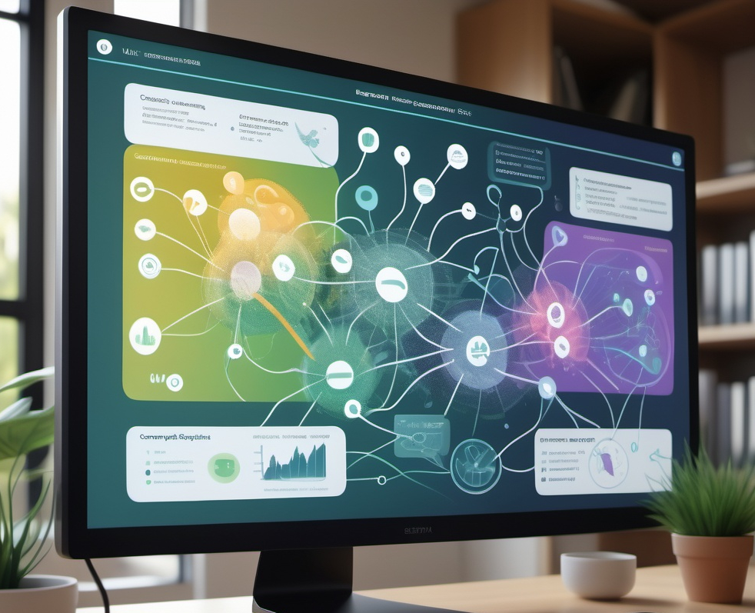
AI-enhanced community intelligence on the global open research ecosystem
cassandra.gouldvanpraag@gmail.com | github:@cassgvp | November 2024
Open research is silo’d, limiting our efficacy for collaboration and understanding of system change
Cassandra Gould van Praag (she/her)

Slide 3
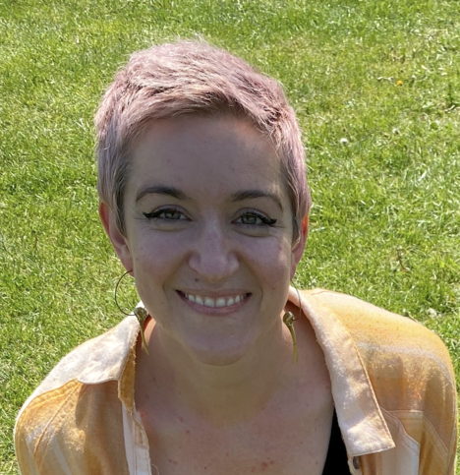
Credentials
Senior Research Community Manager (RCM)
Experience building community strategy, infrastructure and events
Alan Turing Institute, University of Oxford, and independent community groups
Scaffolding engagement, decentralizing power, promoting reproducibility
Large scale data infrastructure and tooling
Open Research Calendar: n>1,300 community contributions since 2021
Actionable stakeholder mapping (tinyurl.com/turing-es-map)
Qualitative and quantitative research skills (PhD brain imaging and Informatics)
Expertise and research data management design and GDPR
Influential open and ethical research advocate
International speaker and leader in open research and EDI
Contributor to global community, monitoring and funding initiatives

Slide 4
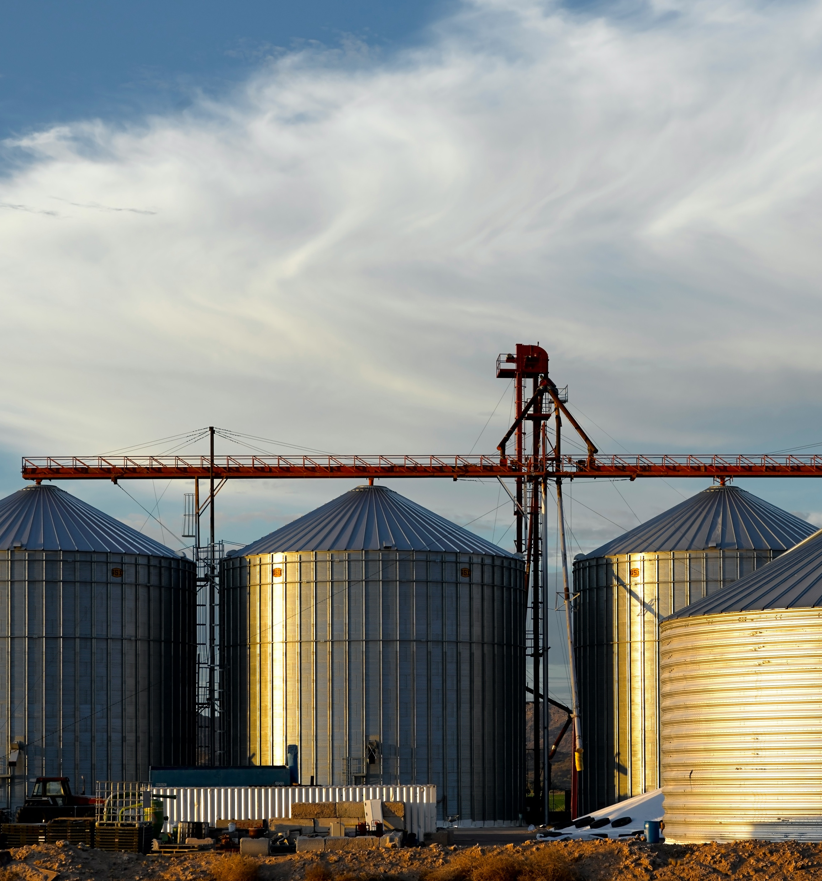
Open research is silo’d
Open research actors in the same city do not know each other
Exclusion, dilution of power, and inefficiencies
Inefficient and inequitable information transfer
Mapping projects have been incomplete and relied on static (expired) data
We cannot effectively strategize for system change with and incomplete map of the ecosystem
Industry intelligence tools can help us understand how our ‘customer’ is engaging with our ‘product’ en mass

Slide 5
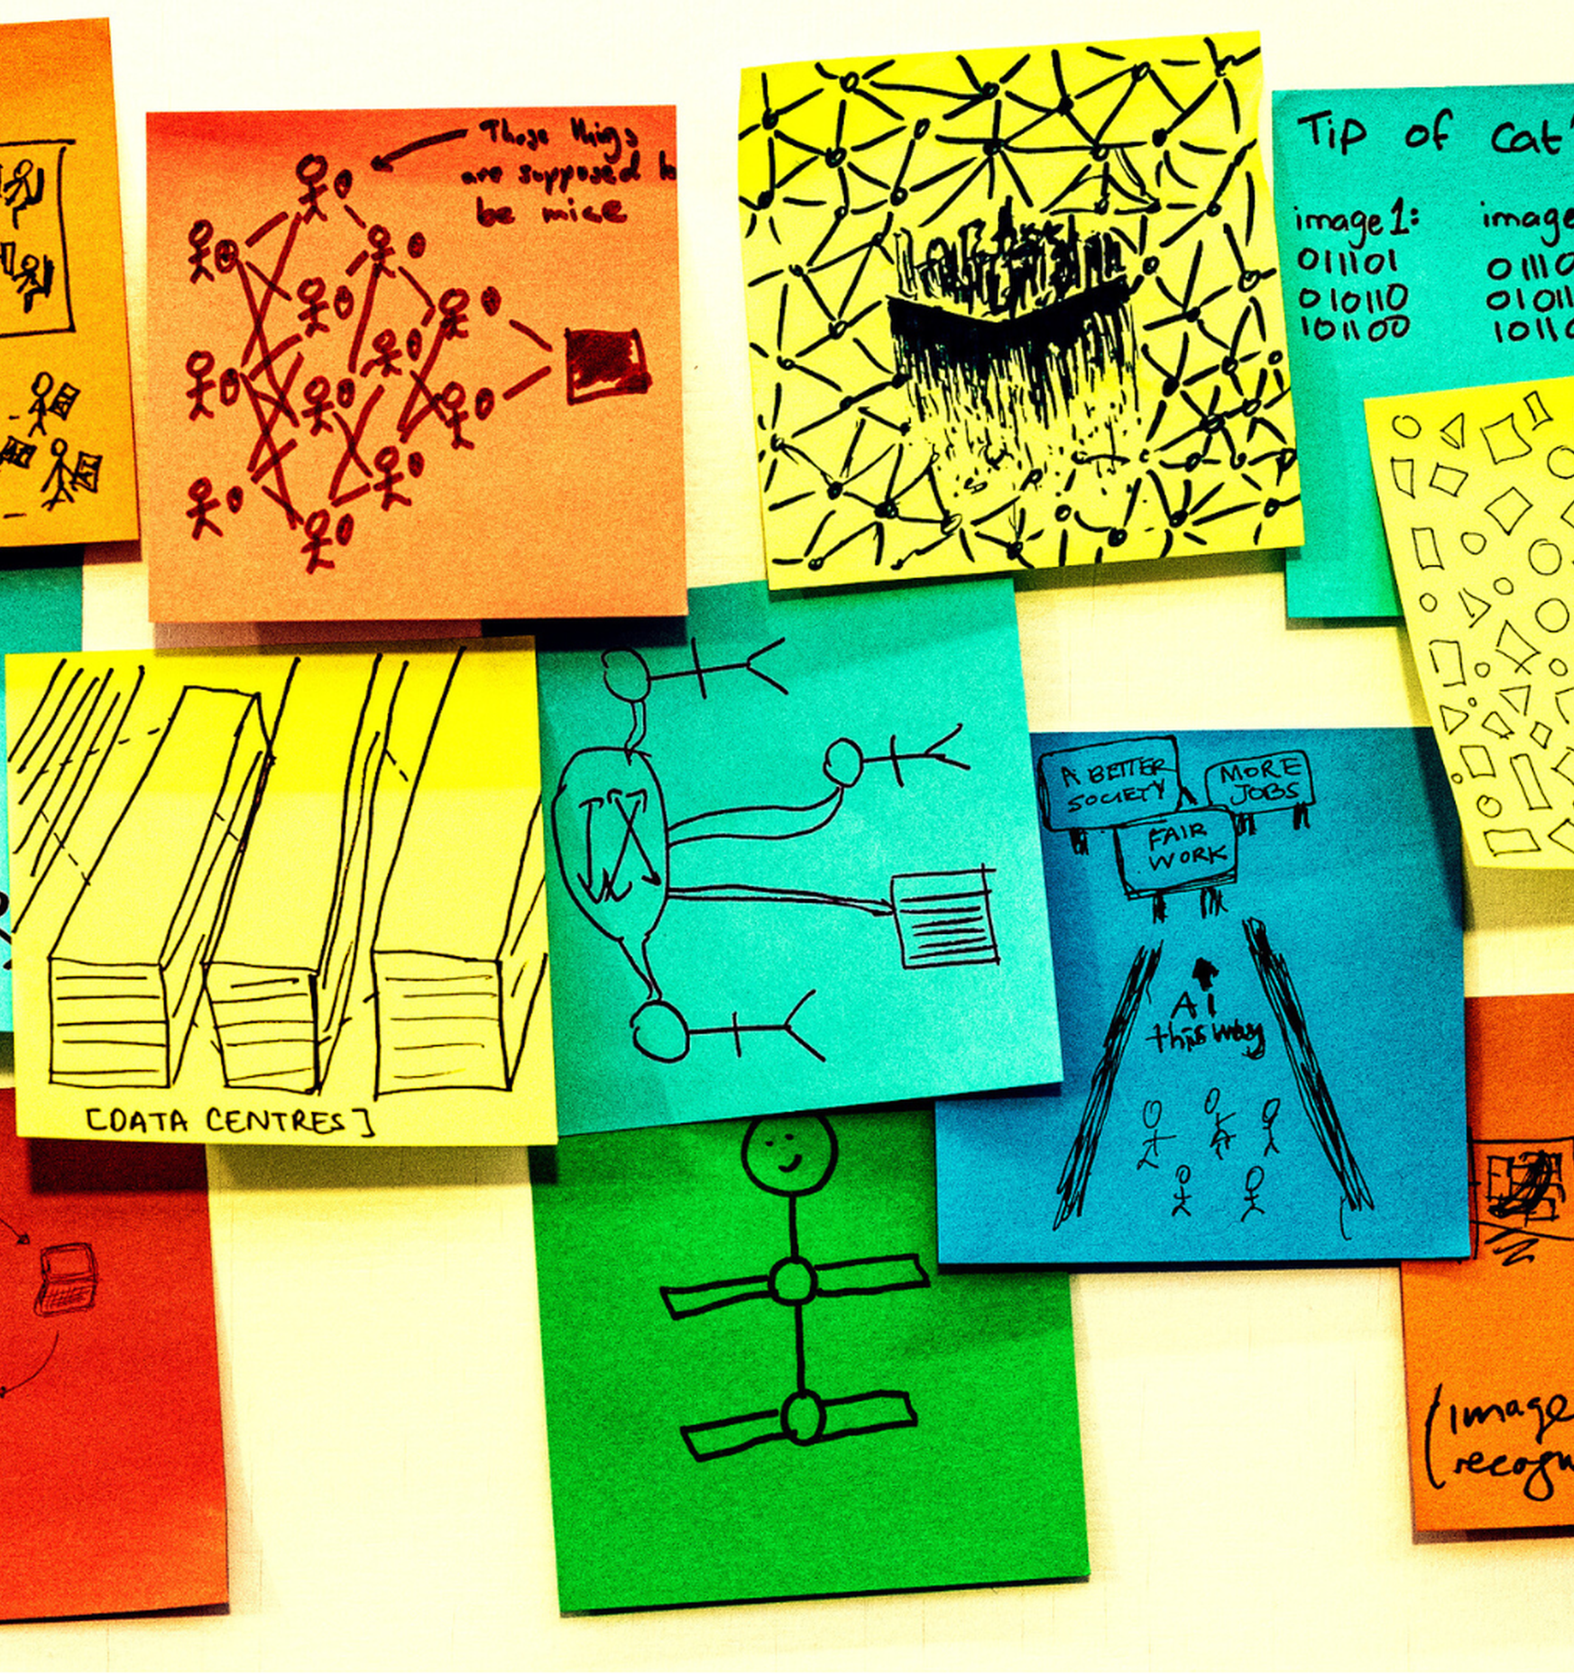
AI-enhanced community intelligence
Rick Payne and team / Better Images of AI / Ai is... Banner / CC-BY 4.0
Build understanding of your customers “buying signals”
LLM analysis of social media etc. to uncover high value conversations, trending topics, pain points
DNN Social Network Analysis to identify “target accounts”
Engagement and influence monitoring
Segmentation based on behaviour profiles
Predictions of behaviour patterns, e.g. following regulatory changes
Linking of data across different systems to understand the activity of a single person (email / username)
Data sources: LinkedIn; Slack; GitHub; Eventbrite; Zoom

Slide 6
AI-enhanced community intelligence
Rick Payne and team / Better Images of AI / Ai is... Banner / CC-BY 4.0
Build understanding of your customers “buying signals”
LLM analysis of social media etc. to uncover high value conversations, trending topics, pain points
DNN Social Network Analysis to identify “target accounts”
Engagement and influence monitoring
Segmentation based on behaviour profiles
Predictions of behaviour patterns, e.g. following regulatory changes
Linking of data across different systems to understand the activity of a single person (email / username)
Data sources: LinkedIn; Slack; GitHub; Eventbrite; Zoom
Community health
Community Relationship Manager (CoRM)

Slide 7
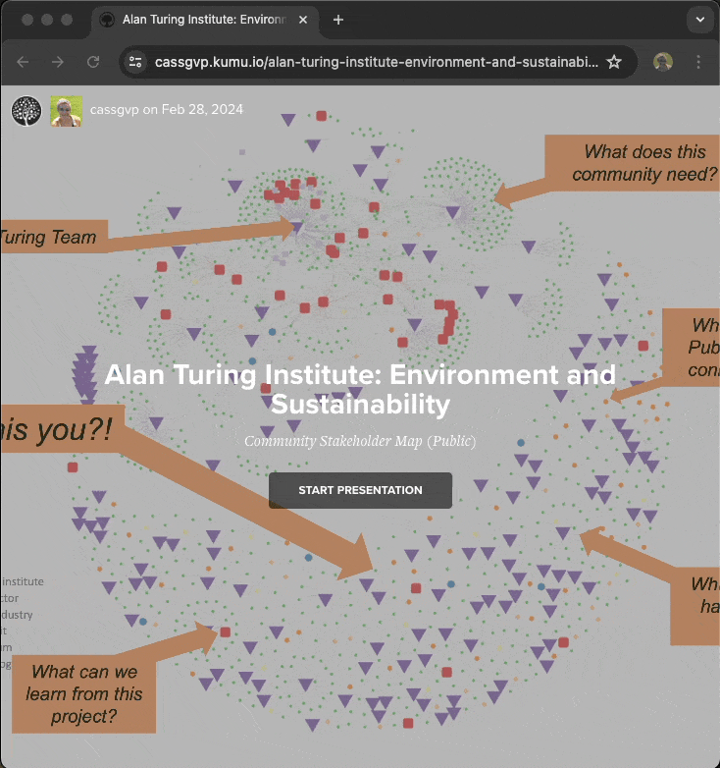
Open research ecosystem map
BUILD An ecosystem map of research communities
Lowering barriers to visibility and collaboration
Big data on engagement AI analysis
USING Commercial go-to-market community strategy
Capitalize on industry tool development
Develop to include research data sources (e.g. Zenodo)
Market (open source) to Research Community Managers
Opt-in data exchange on “open” buying signals
TO DELIVER Sophisticated understanding of impact at scale
AI-guided interpretation of multiple interacting effects
Scalable engagement strategies

Slide 8
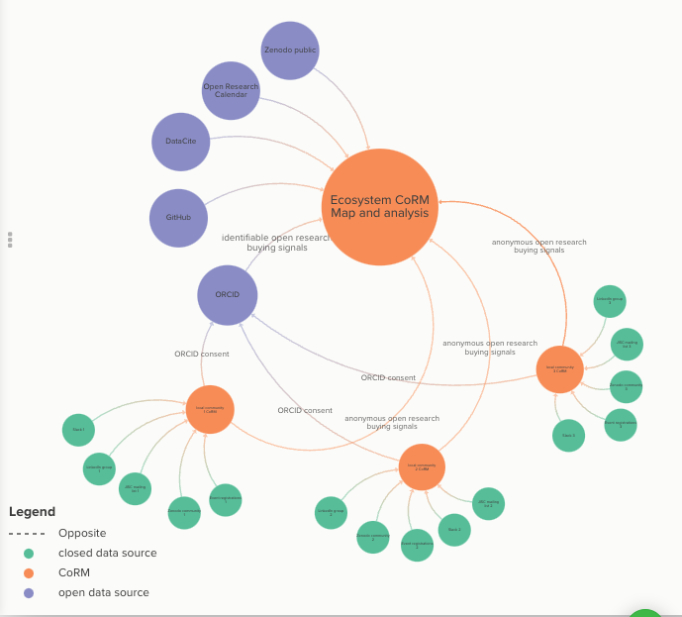
Engagement evidence synthesis
Open Source Community Relationship Manager (CoRM)
Offered as RCM tool to monitor community health, success against objectives etc.
RCM and RAM style development
Market to all types of research communities
Data exchange model
Built-in pathway to submit anonymized data on open research buying signals
Actively market to maximise reach
Ecosystem CoRM
Analyses open data sources
Individuals identifiable with ORCID consent

Slide 9
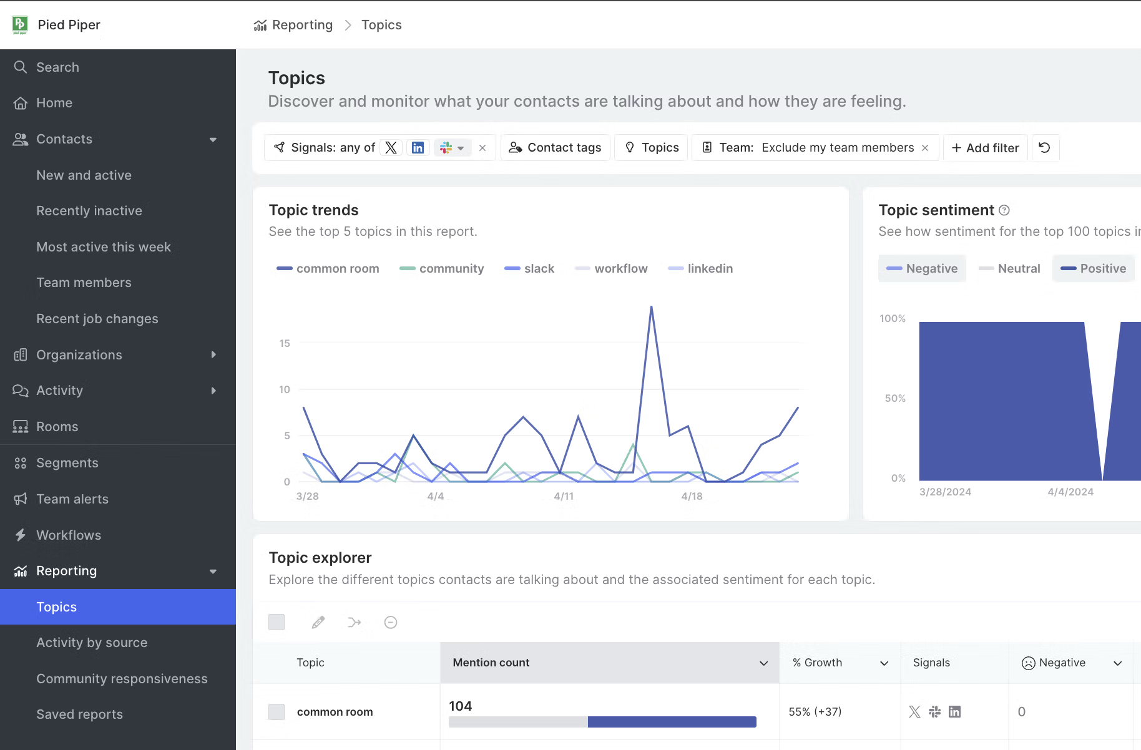
Community Relationship Manager (CoRM)

Slide 10
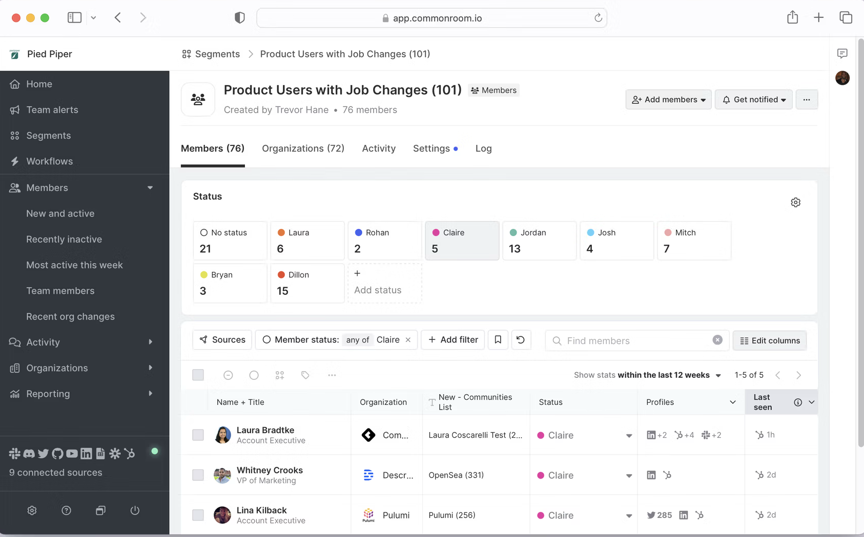
Community Relationship Manager (CoRM)

Slide 11
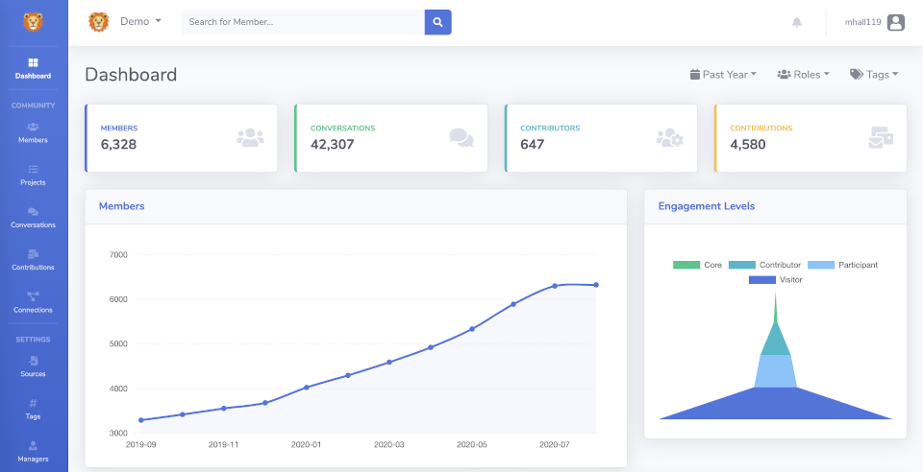
Community Relationship Manager (CoRM)

Slide 12
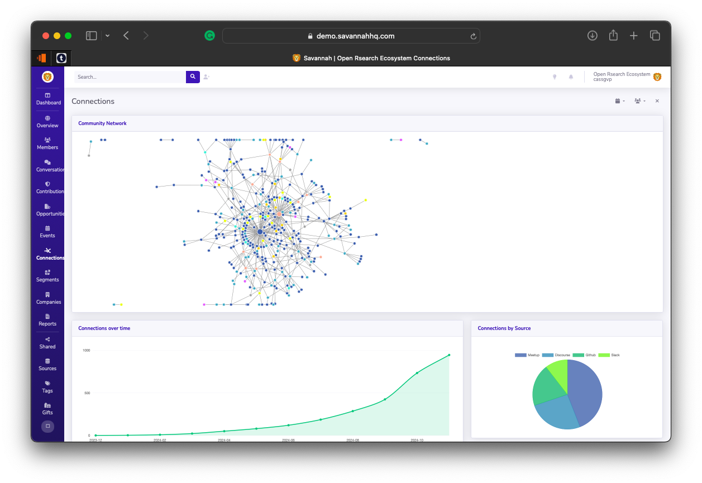
Community Relationship Manager (CoRM)

Slide 13

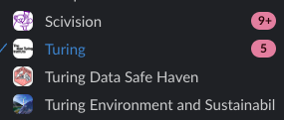
Community Relationship Manager (CoRM)
CSCCE n = 834
OLS n = 817
ORC n = 4
SciVision n = 105
Turing n = 2181
TTW n = 1297
DSH n = 52
CW24 n = 125
E&S n = 780
UKTRE n = 149

Slide 14
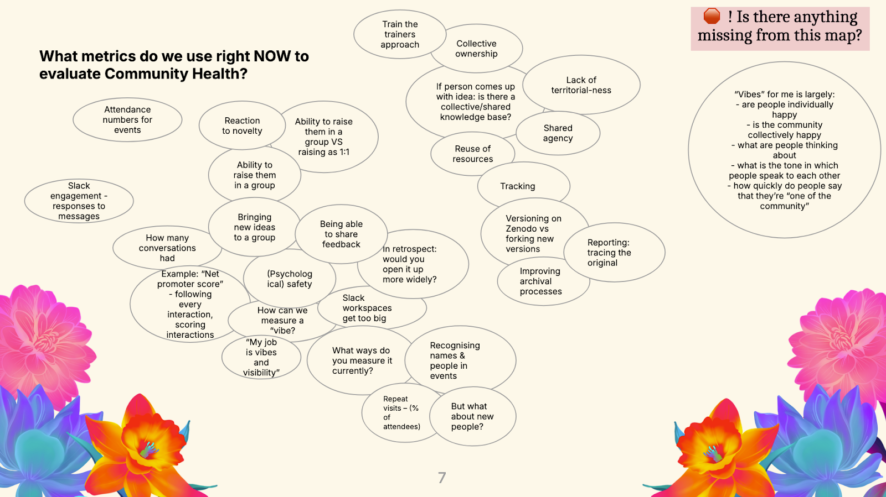
Community Health (Anne + RCMs)
What information sources would you need to integrate to measure these things?
Orgs
People
Outputs
Interactions
“Solve for many”

Slide 15
Existing solutions
The Research Software Alliance list of research software communities (2019)
Limited scope, no interactive data analysis
Access2Perspectives map of open science resources (2022)
Does not contain people or engagement signals; not intended for use in developing strategy
Open Future map of Open org Twitter followers (2023)
Data is static and includes people only
UNESCO open science capacity building index (2023)
Data collected by a fixed timepoint survey. Intentionally limited to large scale activities. Covers only open science resources, not people or adoption signals. Data is not interactive
NumFOCUS Map of Open Source Science (proof of concept 2024)
Interactive data of open source research software projects, research papers, organisations, patents, datasets, funding pathways, AI models and applications, and people. No coverage of adoption signals for strategic planning
Invest in open mapping of the research software ecosystem (grant awarded September 2024)
Aiming to generate a comprehensive understanding of the current needs and dependencies in the research software ecosystem and uncovering future opportunities to advance its sustainability and resilience.

Slide 16
Professional skills and gaps
Well skilled
Strategy
Community management
Events
Qualitative and quantitative analysis
Resourced (Access To Work Support Worker)
Administration
Project management
Additional skills required
Research software engineering
- LLMs and DNNs
- Deployable solutions
- Data ingress and wrangling
Later: RCMs, RAMs, Project Manager

Slide 17
Open sourcing
Open by design
Documentation CC-BY-4.0
Training CC-BY-4.0
Code MIT – TBC by discussion in the community
Data CC-BY-NC – TBC by discussion in the community

Slide 18
Roadmap
1. Stakeholder research
Collate information about active communities, activities, policies, actors in open research.
2. Stakeholder engagement
Building Community of Developers and Community of Users. Listening.
3. Tool development
Open by design
4. Engagement (Phase 1)
Publish and socialise CoRM for early community updates and improvement of user experience.
5. Engagement (Phase 2)
Formal and diverse qualitative stakeholder analysis to determine community needs and value return.
6. Analysis
“State of the ecosystem” paper and proposal of go-to-market strategy
7. Sustainability
Develop governance and document pathways to leadership and funding.
8. System change
Use mapped data to evidence, understand and facilitate adoption of open research principles.

Slide 19
Milestones
Q1. Set up
- Consultants engaged
- Key stakeholders engaged
- Tool requirements agreed
- Community docs and roadmap shared
Q2. Prototype
- Prototype deployed
- UX and design testing
- Community engagement systems in use
Q3. Hackathon
- Community aims and outputs agreed
- Governance agreed
- Funders engaged
Q4. Sustainability
- Funding for Y2-4 secured
- Key stakeholder memorandums of understanding in place

Slide 20
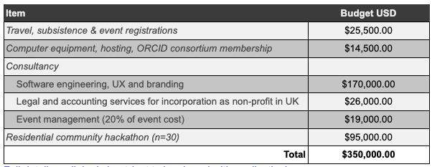
Budget

